Slide 1
Search & View Inspection Inventory From Mobile

Slide 2
Agenda
- Enables customer to be able to view entire Inspection Portfolio from the app

Slide 3
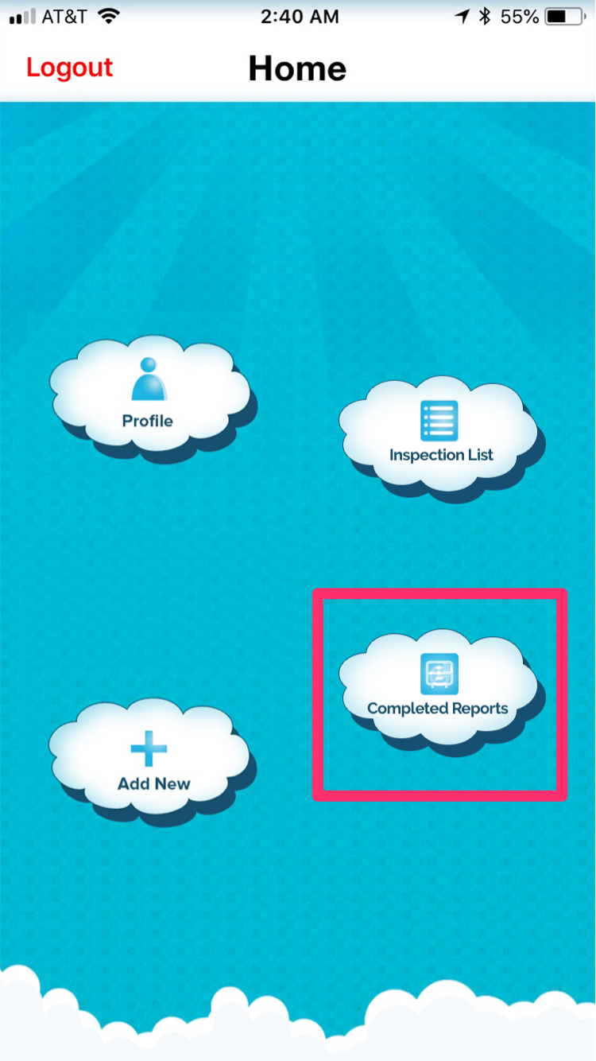
Customer clicks
“Completed Reports”
using any mobile device
they log in from

Slide 4
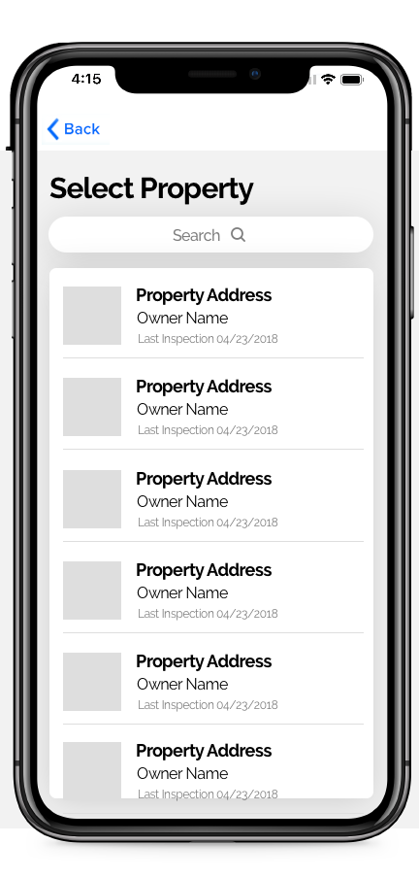
Select Property
Search and select from
property inventory

Slide 5
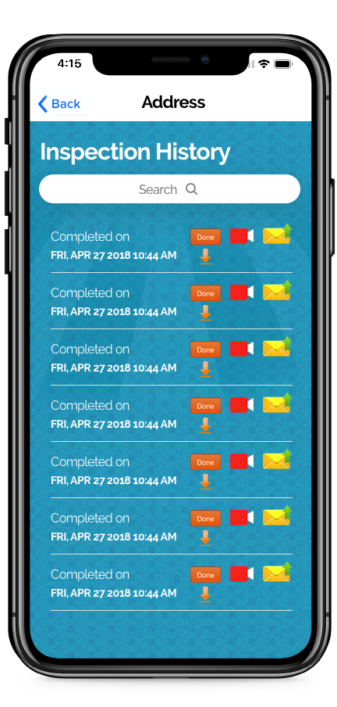
Inspection History
Can now select the
Download and QuickView
links from the property's
inspection history

Slide 6
End Result
Easily view your Inspection Portfolio, Video Reports, and Email Inspections from anywhere!

Slide 7
Thank you for your feedback!

