Slide 2
Agenda
- Resident Inspection enables property managers to assign tenants to complete their move-in inventory inspections from their mobile device.

Slide 3
Simple Steps
1
2
3
4
5 Minute Easy Setup
Tenant Request App
Login
Tenant Completes
Move In
Property Manager can
Compare with Existing Inspection

Slide 4
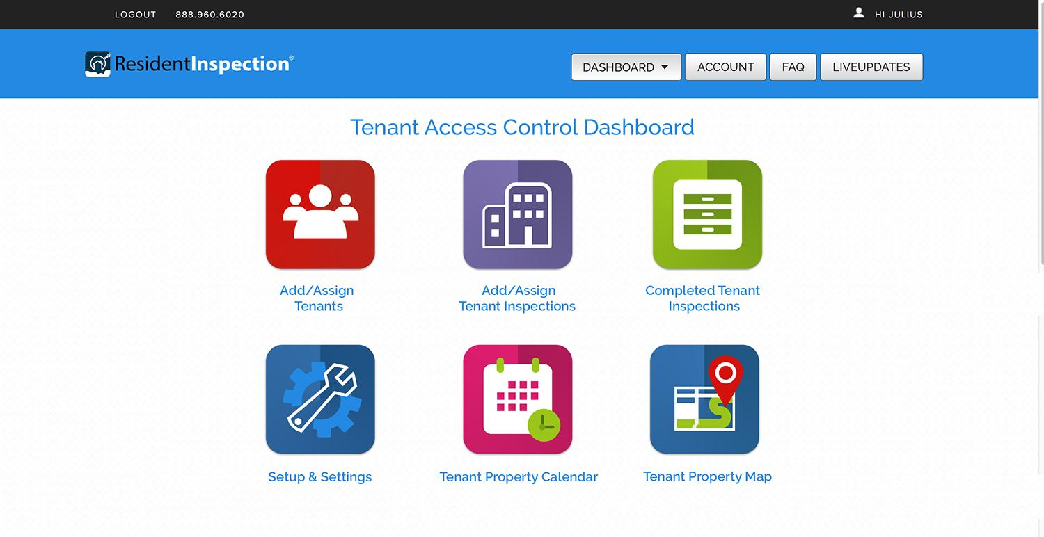
Tenant Control Dashboard

Slide 5
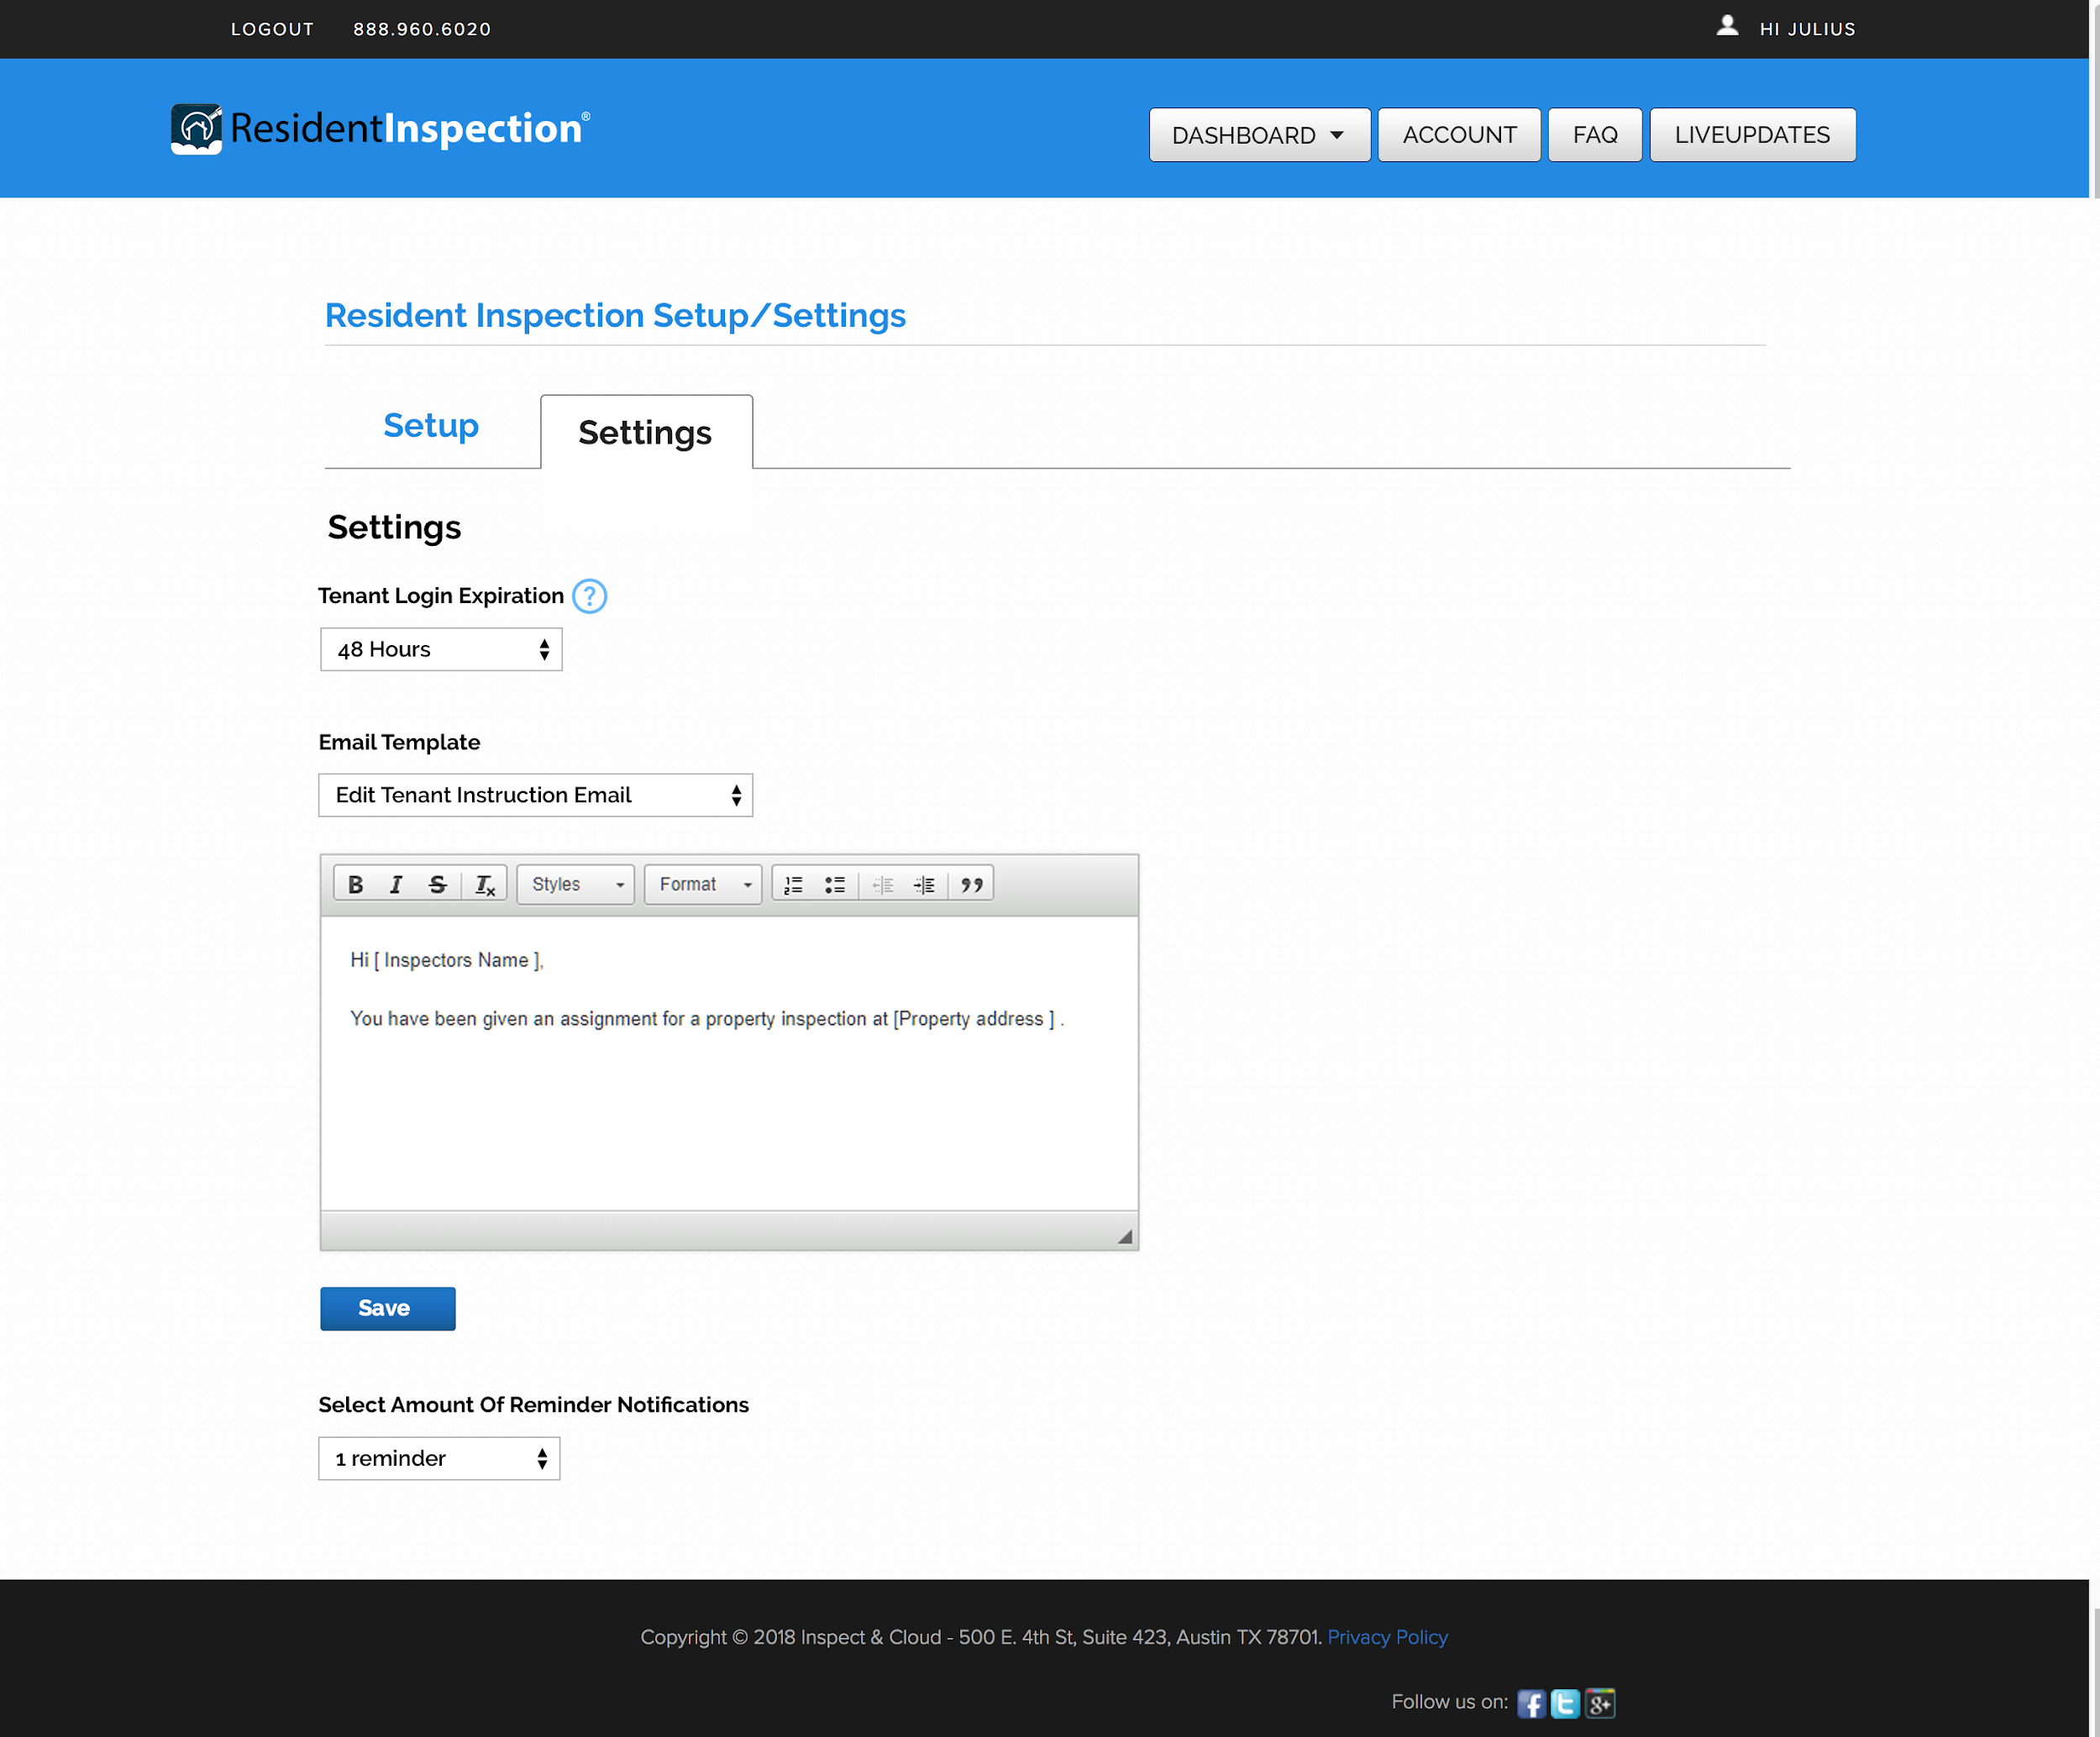
Set login expiration and reminders

Slide 6
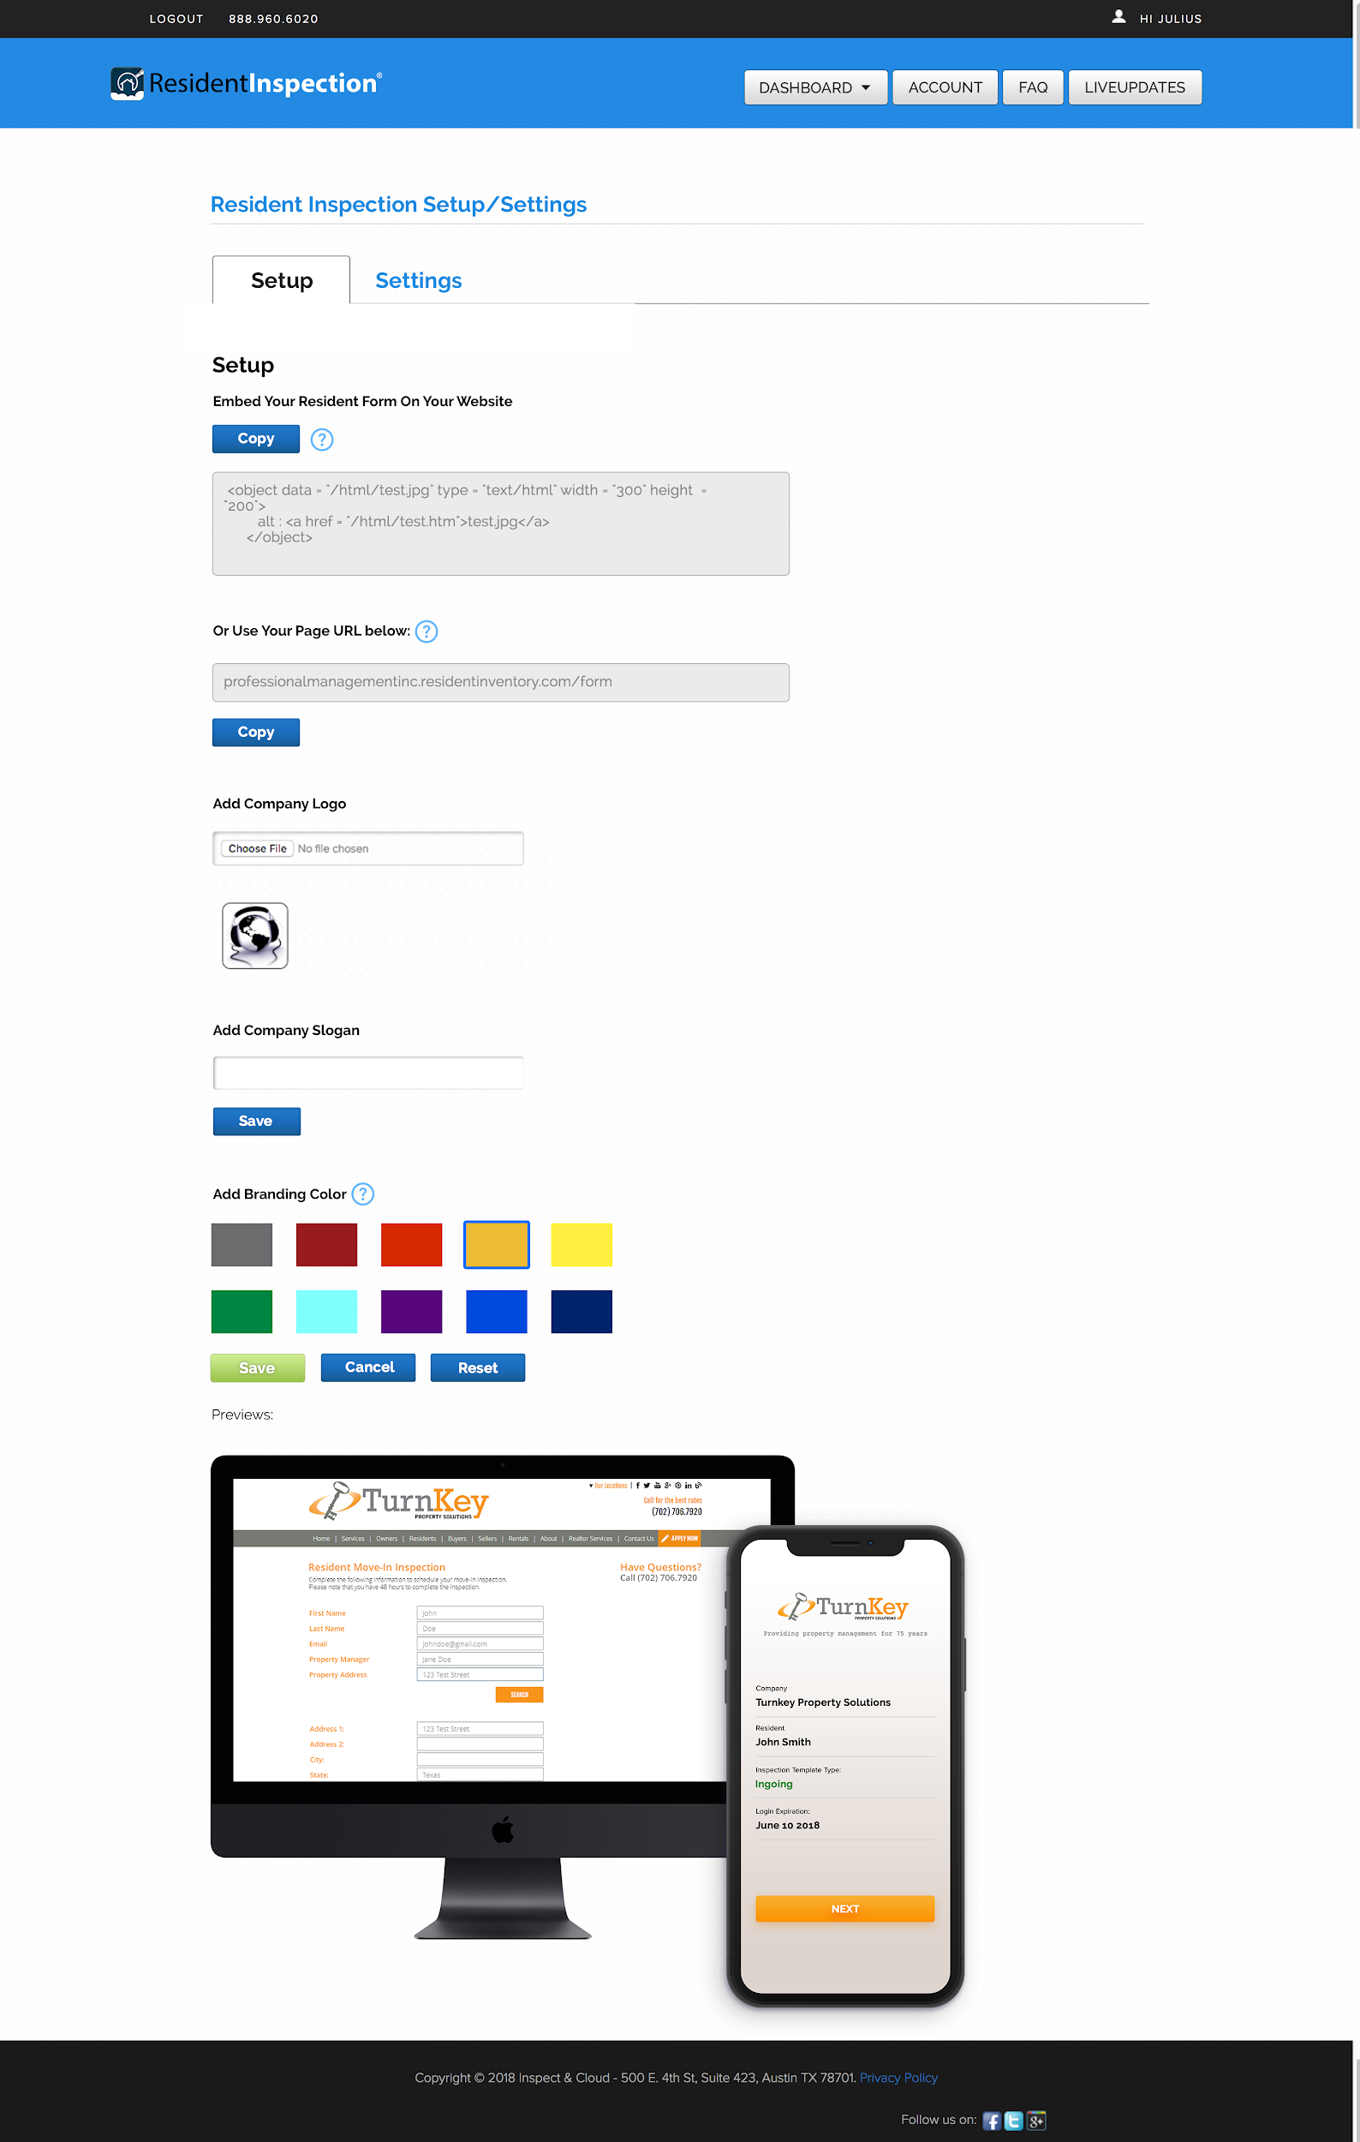
Easy Set Up
1) Resident Login
Request Form can
be displayed on your site
2) Select colors for
Company branding

Slide 7
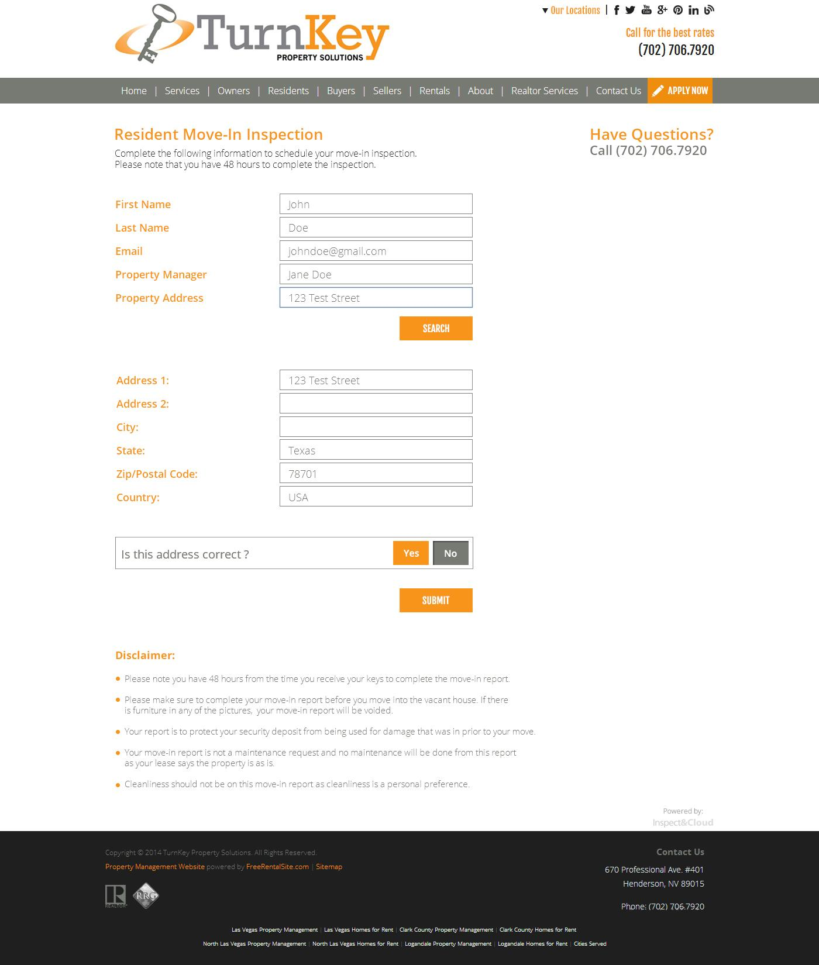
Embed
Tenant uses Login
Request form to receive
login credentials to app

Slide 8
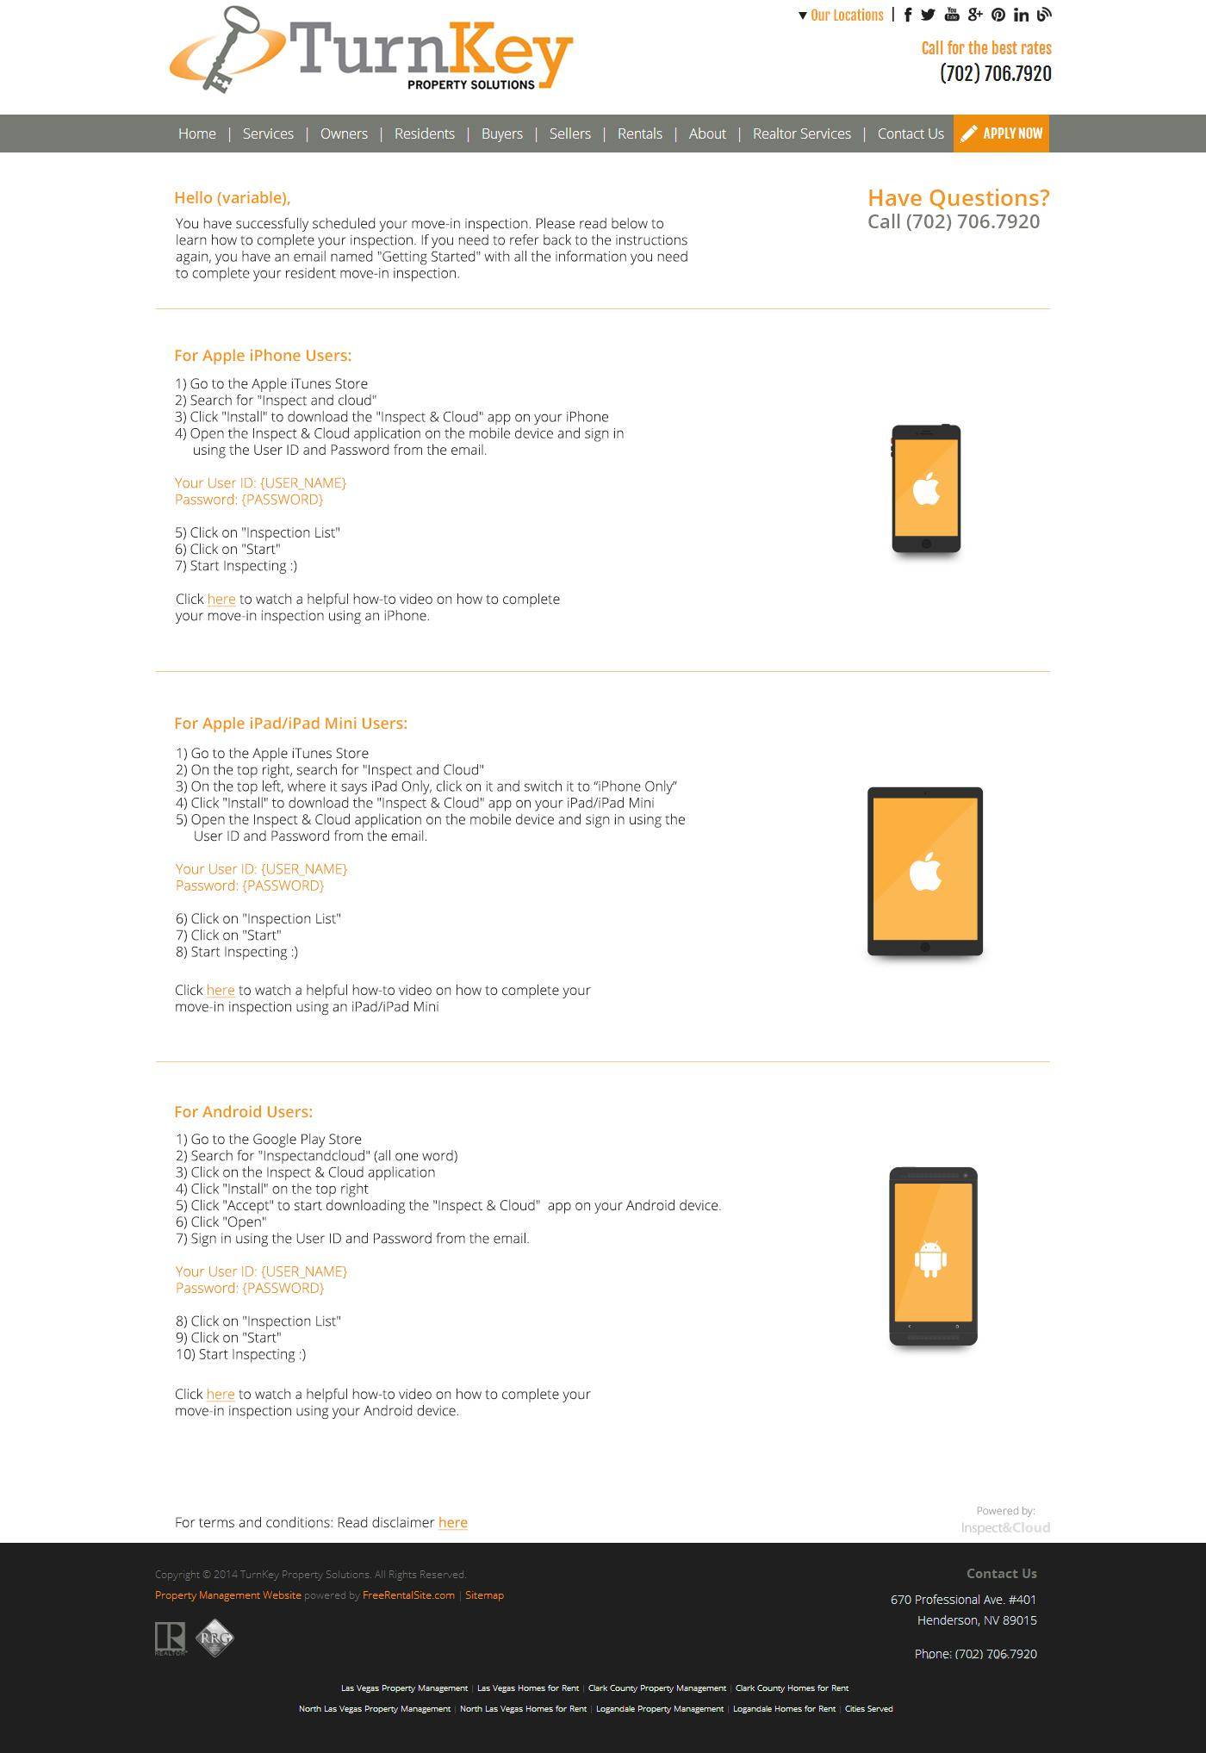
Tenant receives app
Login instructions

Slide 9
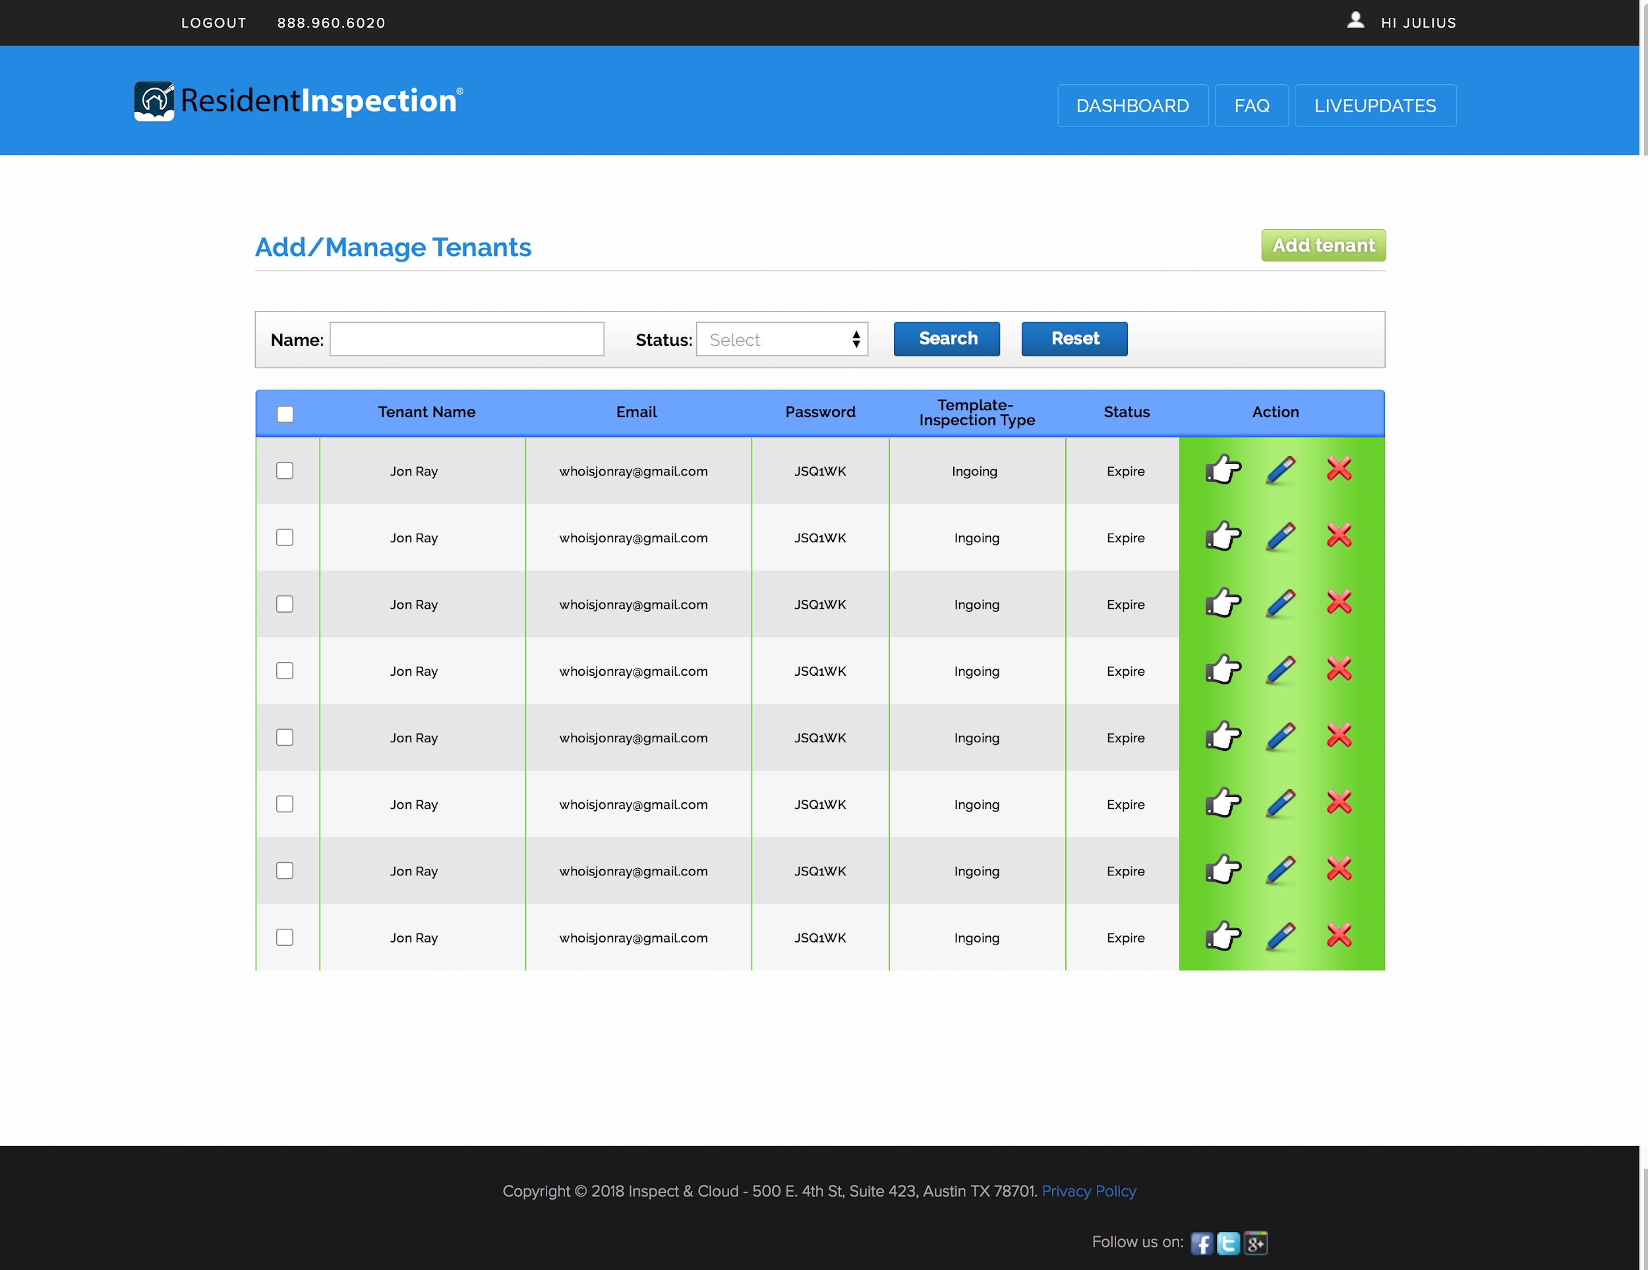
Manage Tenants

Slide 10
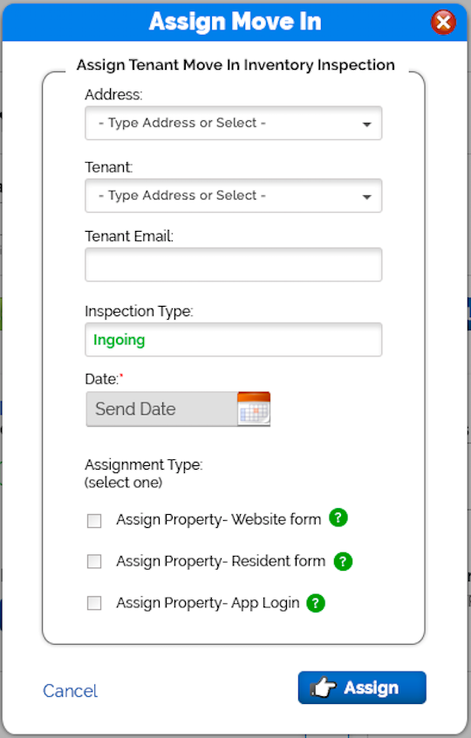
Property Manager
Assigns Move-In
Tenant Receives
notification to complete
Inventory Inspection

Slide 11
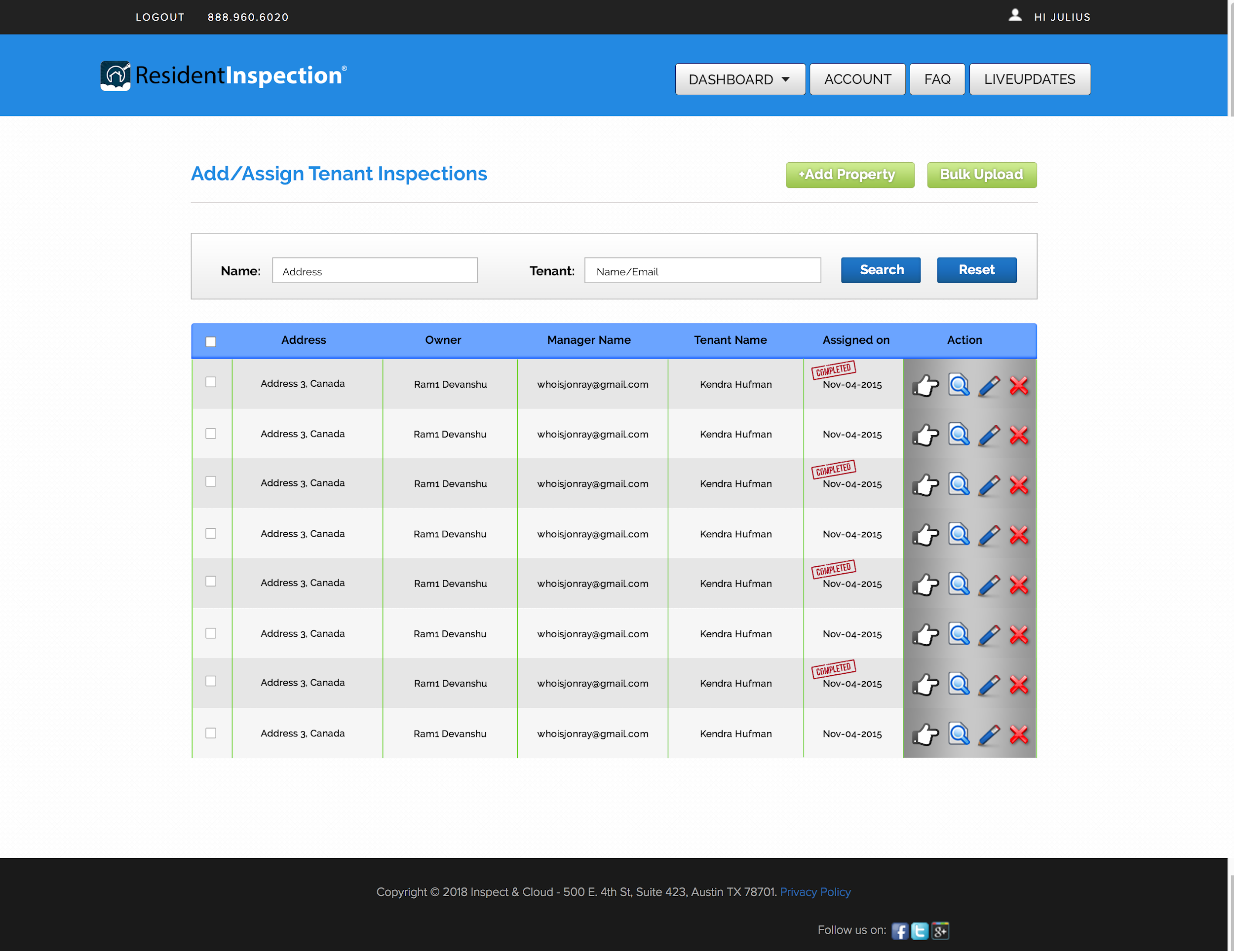
Review Pending Tenant Inspections

Slide 12
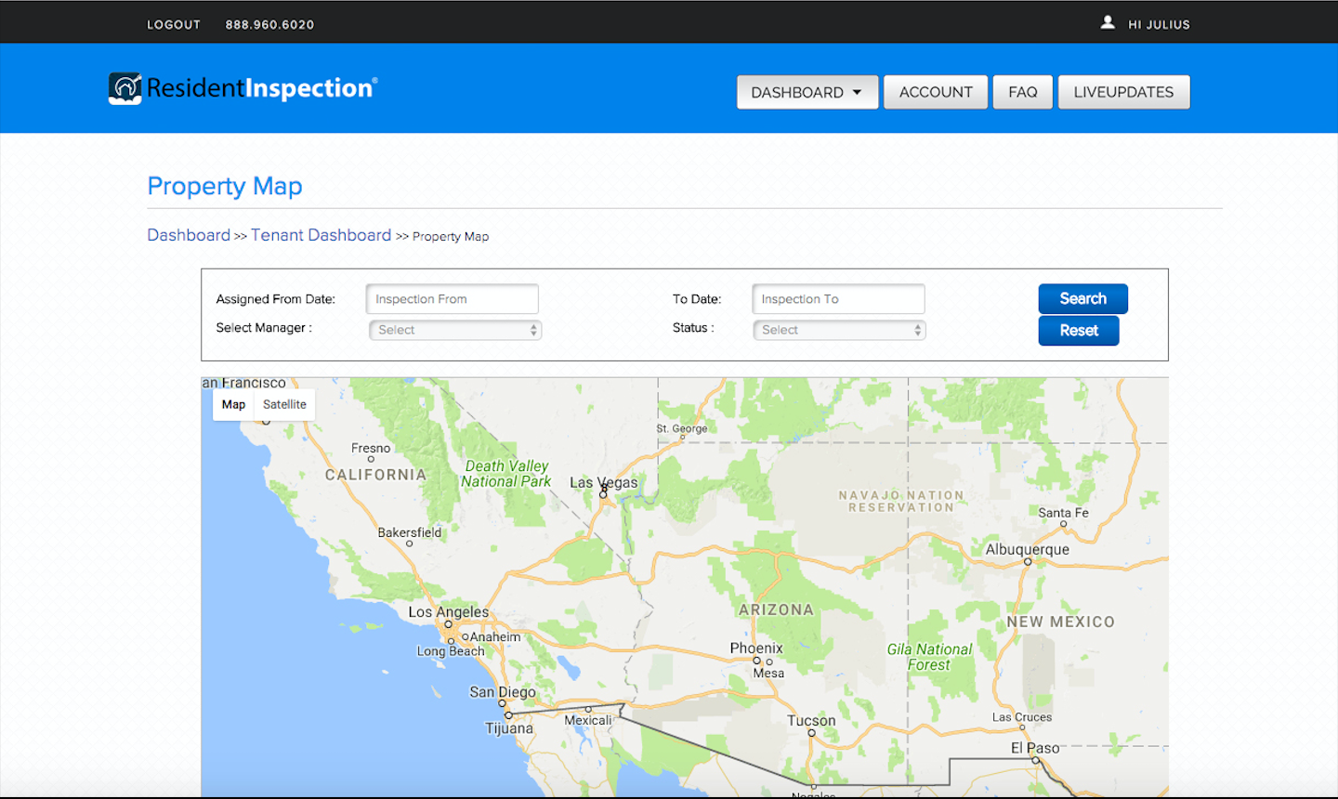
Tenant Property Map displays data using Google Maps

Slide 13
Mobile App
Mobile App name on Appstore/Playstore is different from product “Resident Inventory”.
This enables better company branding for p.m. so that software details are not easily viewable to tenants.

Slide 14
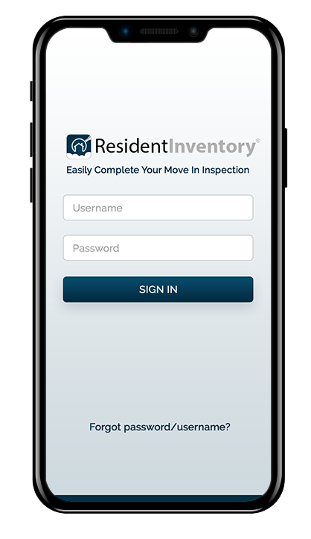
Mobile App
Neutral Login/Look
Tenants enter
assigned login

Slide 15
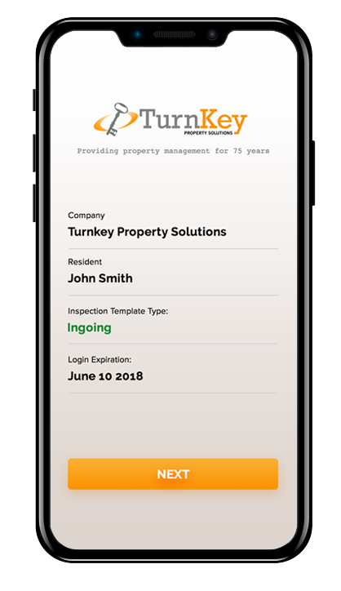
Mobile App
After Logged In
Customer logo
Slogan
Tenant name
Inspection type

Slide 16
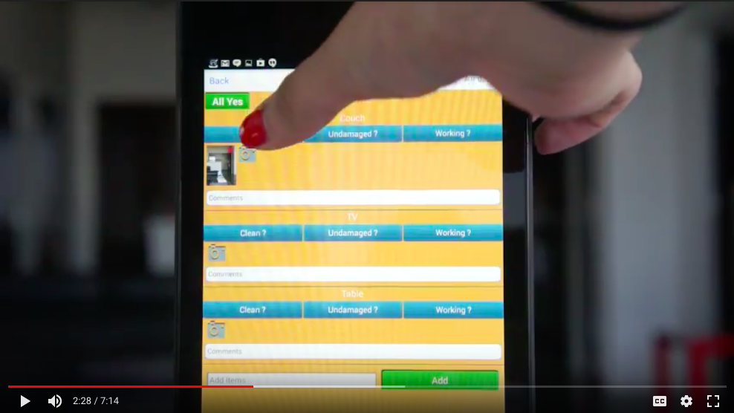
Mobile App
Displays Your
Company Branding
Background Color

Slide 17
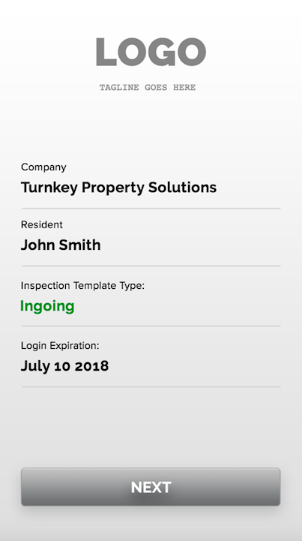
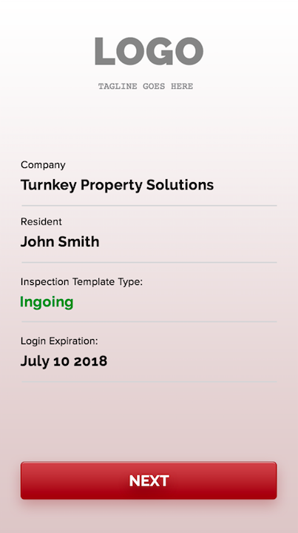
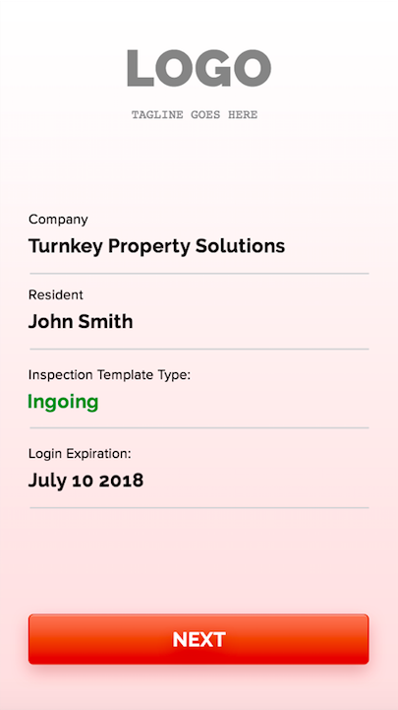
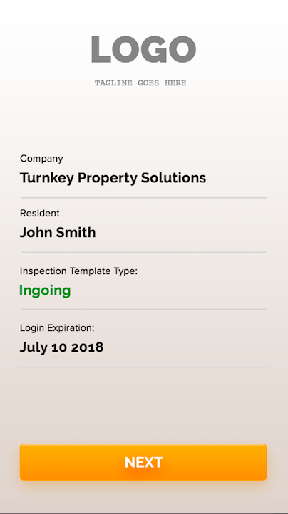
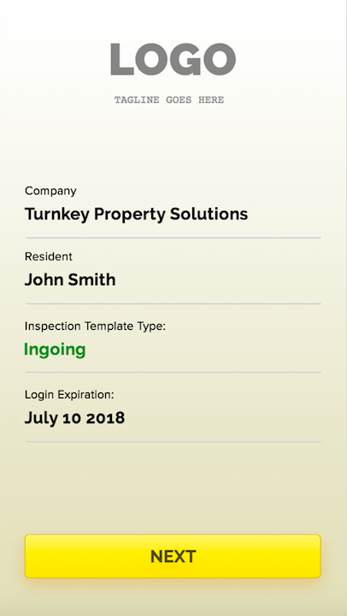
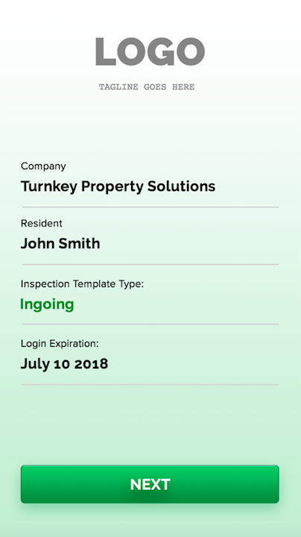
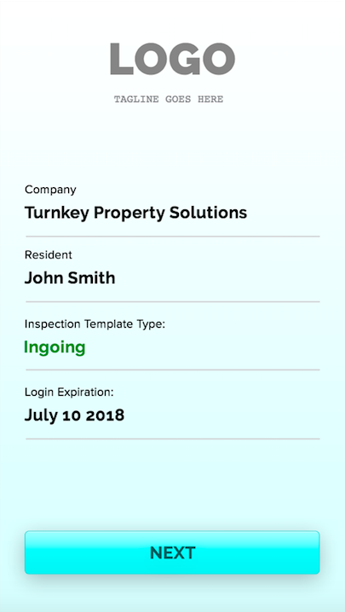
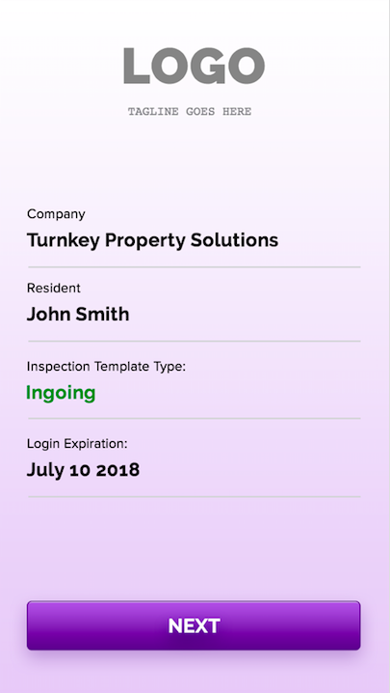
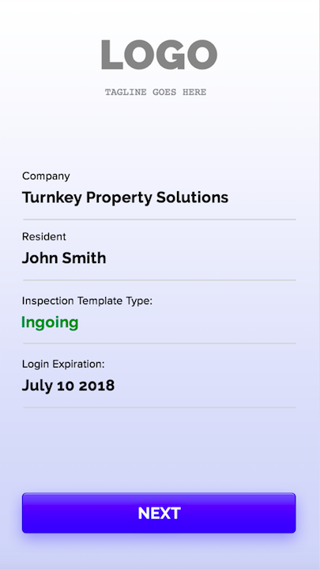
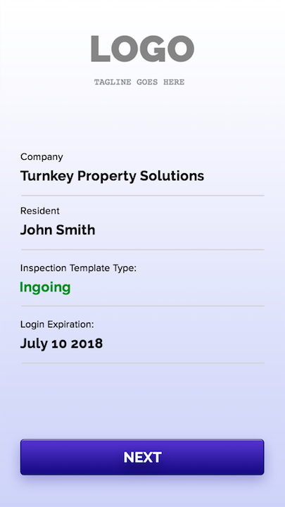
Company Home Logo Screen

Slide 18
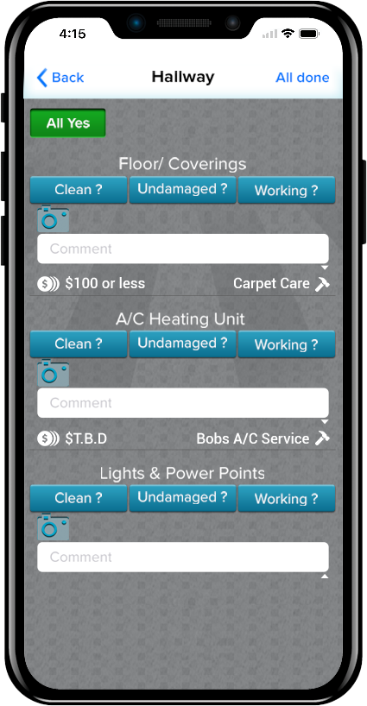
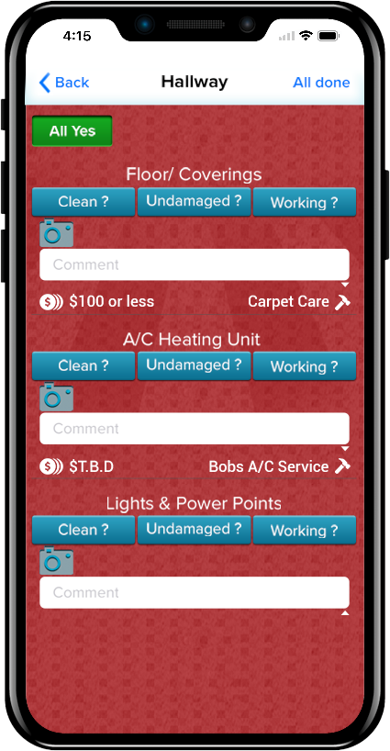
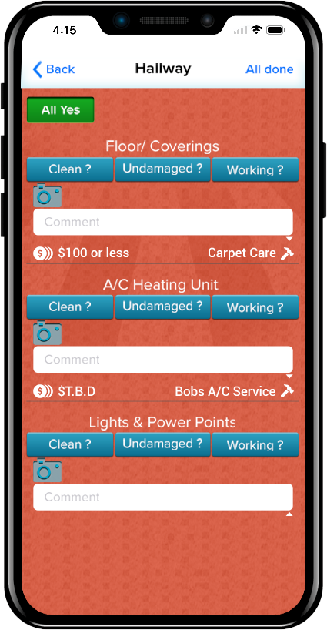
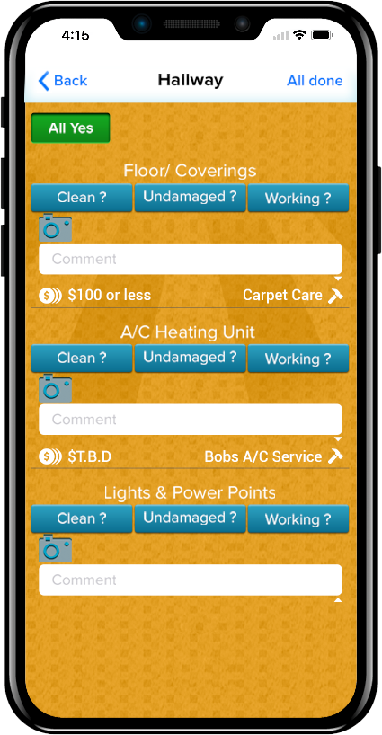
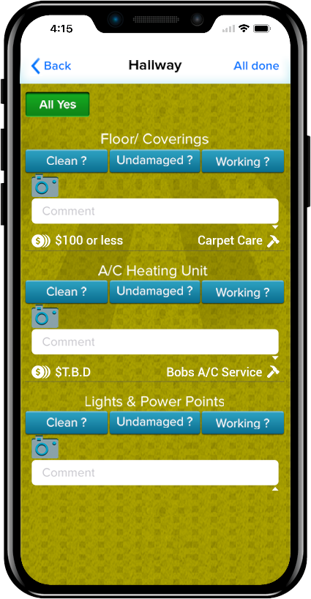
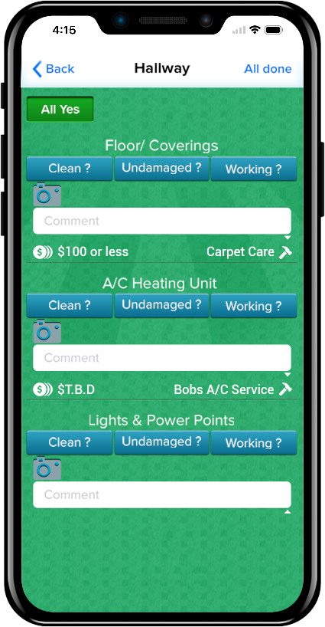
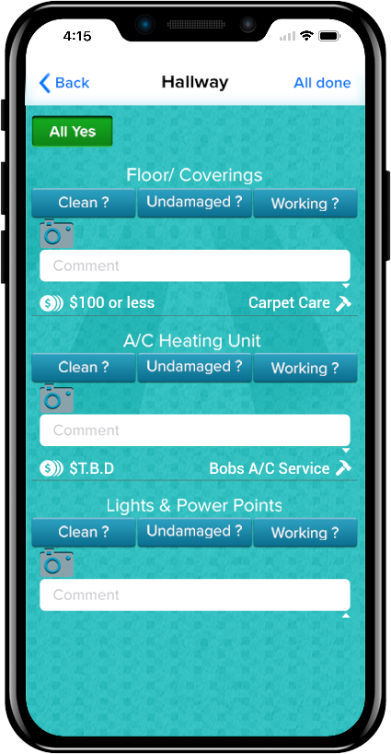
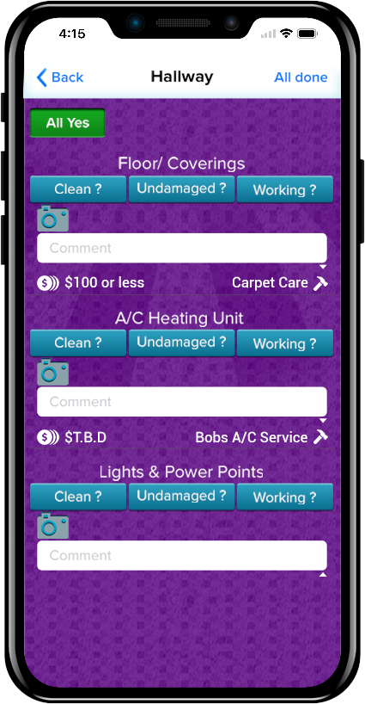
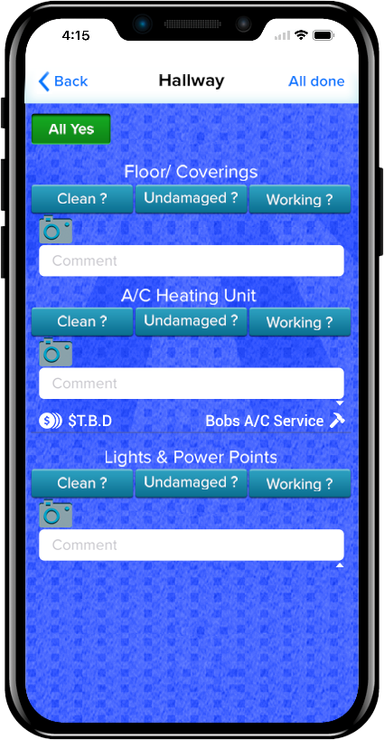
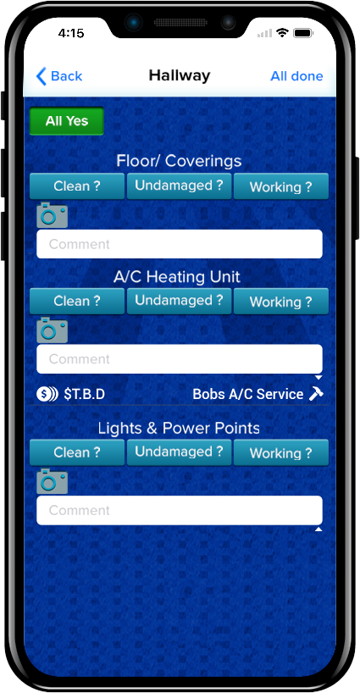
Branded User Experience

Slide 19
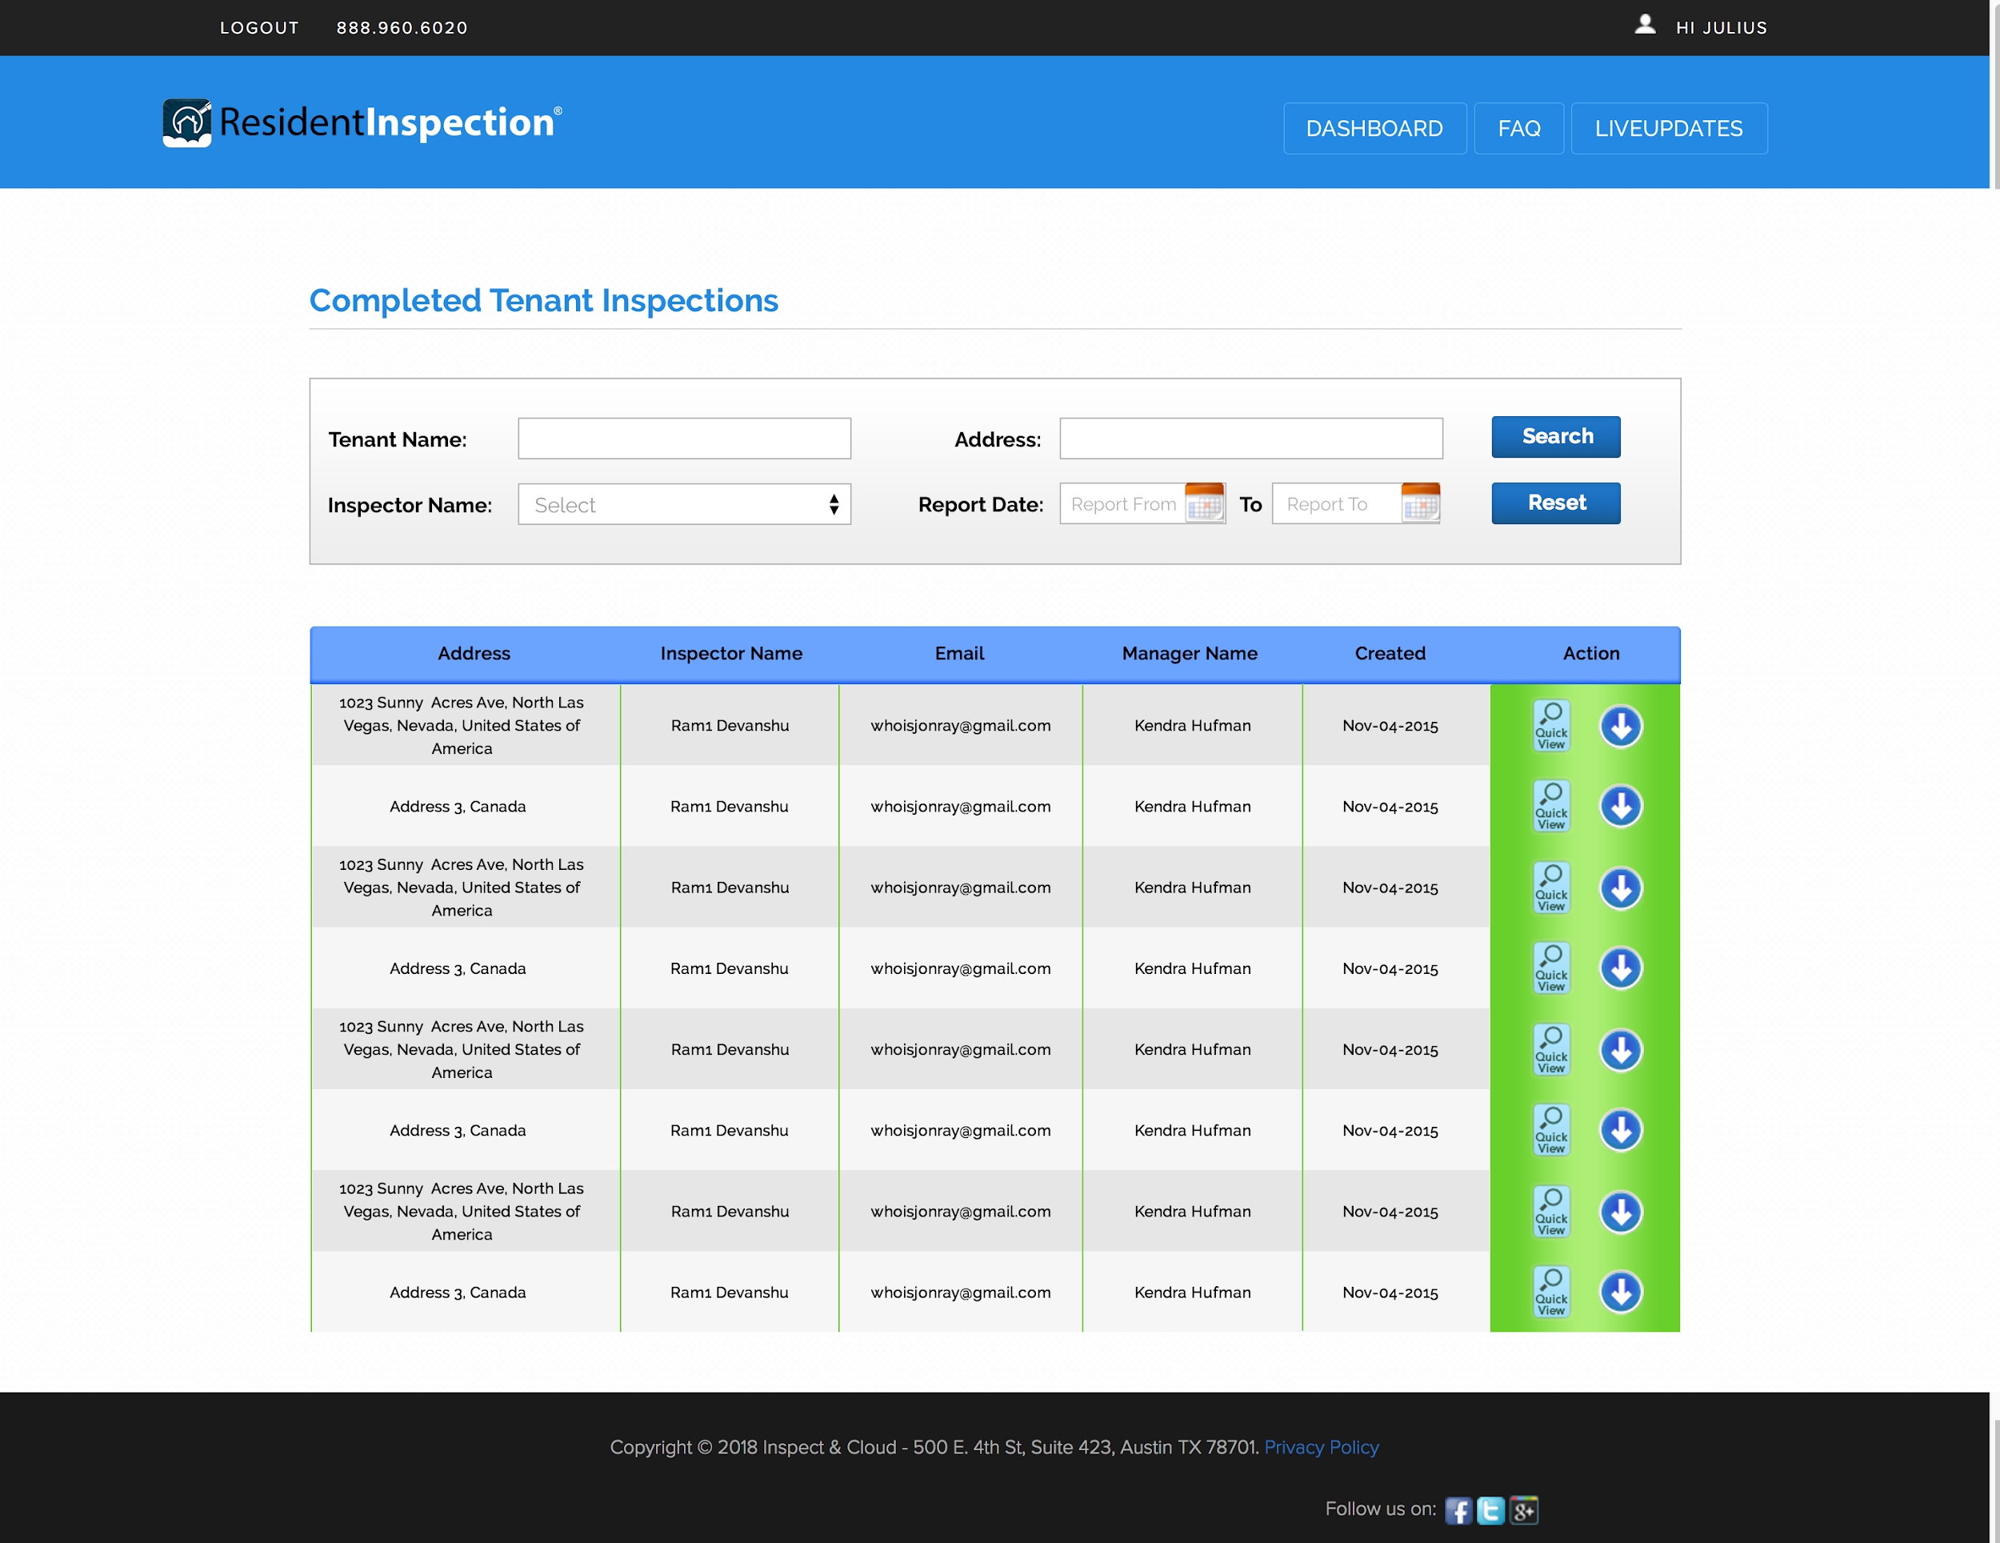
Completed Tenant Inspections

Slide 20
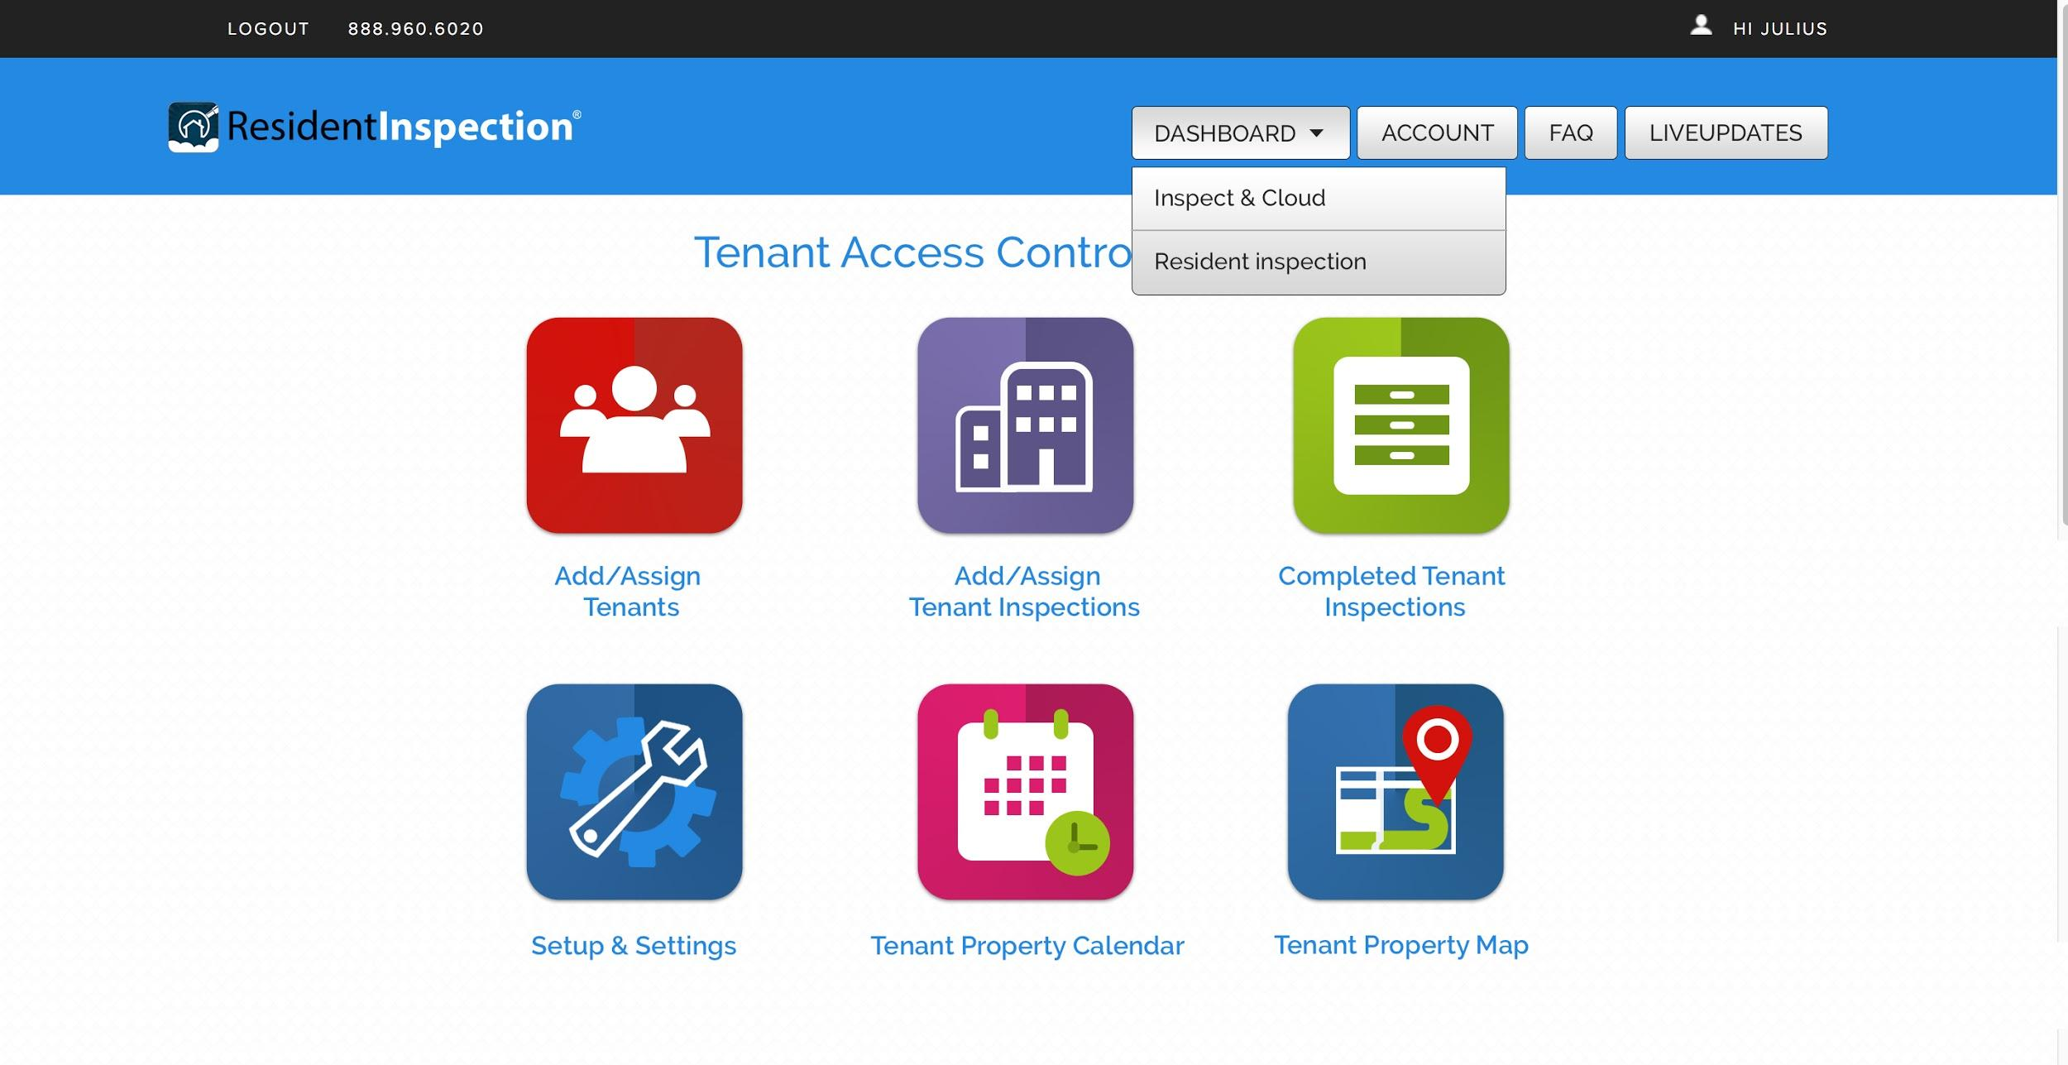
Integrates with I&C or works as a
standalone

Slide 21
End Result
Easily compare all tenant move-in reports with your existing inspections for simple automation and easy side by side move in/out comparison.

Slide 22
Pricing
Benefits
- White Label Customized Branding - when tenants login to the app they see your company branding with your logo, slogan, and colors.
- Branded Report URL’s - your company name is displayed in url’s for inspections.
- Unlimited Tenant Logins, Unlimited Inspections - no additional fees
- Unlimited Storage
- Side by Side Comparison - compare your existing inspections with Tenant move-ins.

Slide 23
Pricing
Retail Cost to Custom build an app can range from $10,000- $25,000
Architecture and cloud storage can cost tens of thousands.
Ongoing Maintenance cost, etc.
Savings
Office is notified faster when tenants complete move-in inspections
Compare to existing inspections faster
Reduce Security Deposit Disputes. Require photos to accompany discrepancy comments to prevent tenants from falsifying damages.
Resident Inspection
Only $49mo - no setup fees
Or Free - with a minimum Inspect & Cloud membership of $49mo.

Slide 24
Thank you for choosing

