Slide 1
Add New Property From Mobile
Using Existing Properties

Slide 2
Agenda
- Customer requested method to Add New Property from mobile and prevent duplicate properties

Slide 3
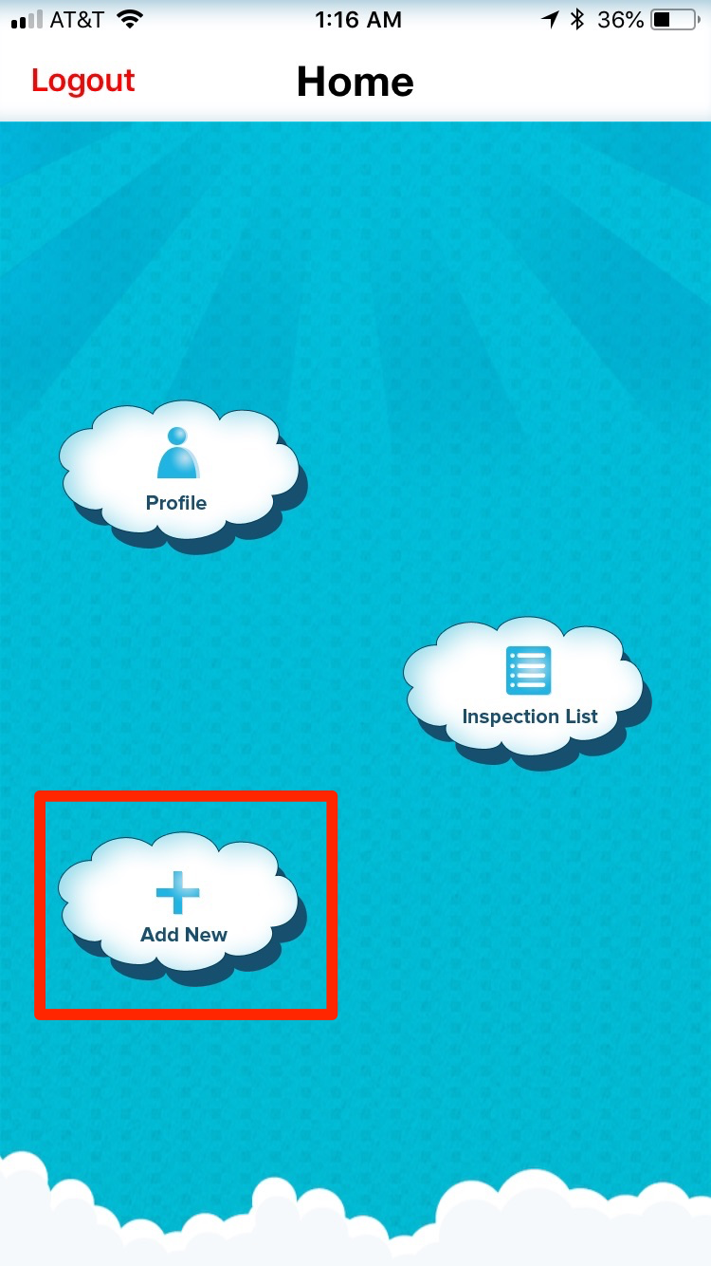
Customer first clicks
Add New from Mobile

Slide 4
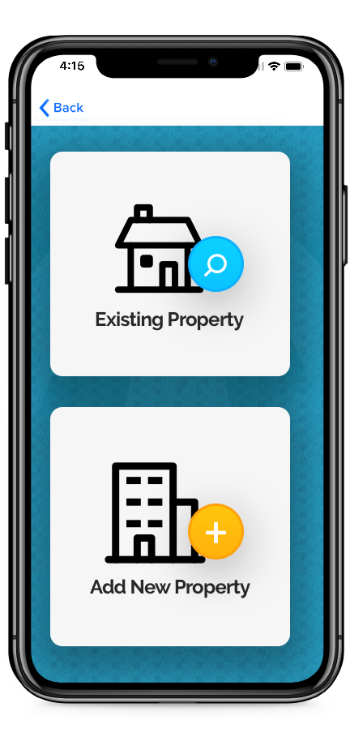
Add New Sub Window
Existing- queries
Customers properties
Add New- uses existing
Add method

Slide 5
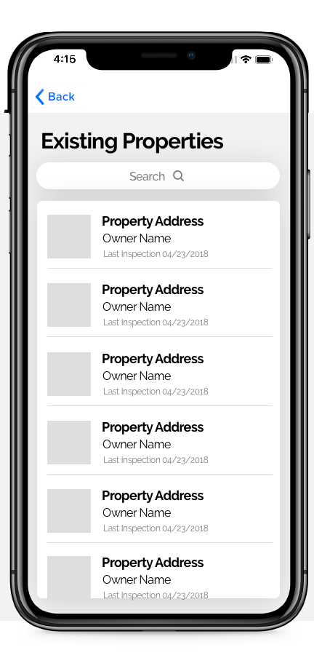
Existing Properties
Searches from customers
properties and once
selected auto populates
to add new

Slide 6
Thank you for your feedback!

